Slide 1


Adapting Index-based Livestock Insurance (IBLI) for Ethiopia:
Logic and Design
Christopher B. Barrett
Cornell University
Workshop at International Livestock Research Institute Addis Ababa, Ethiopia
July 12, 2010

Slide 2
The Case for IBLI For more information
No need to take notes … for more information:
Visit web site: http://www.ilri.org/ibli/
Barrett, C. et al. (2008). “Altering Poverty Dynamics with Index Insurance,” BASIS Brief 2008-08.
Carter, M.R., et al. (2008). “Insuring the Never-before Insured: Explaining Index Insurance through Financial Education Games,” BASIS Brief 2008-07.
Chantarat,S. et al. (2009). "The Performance of Index Based Livestock Insurance: Ex Ante Assessment in the Presence of A Poverty Trap,” Cornell/ILRI working paper.
Barrett, C.B. and M.R. Carter (2007). “Asset Thresholds and Social Protection,” IDS Bulletin 38(3):34-38.
Etc.
Notes:
2

Slide 3
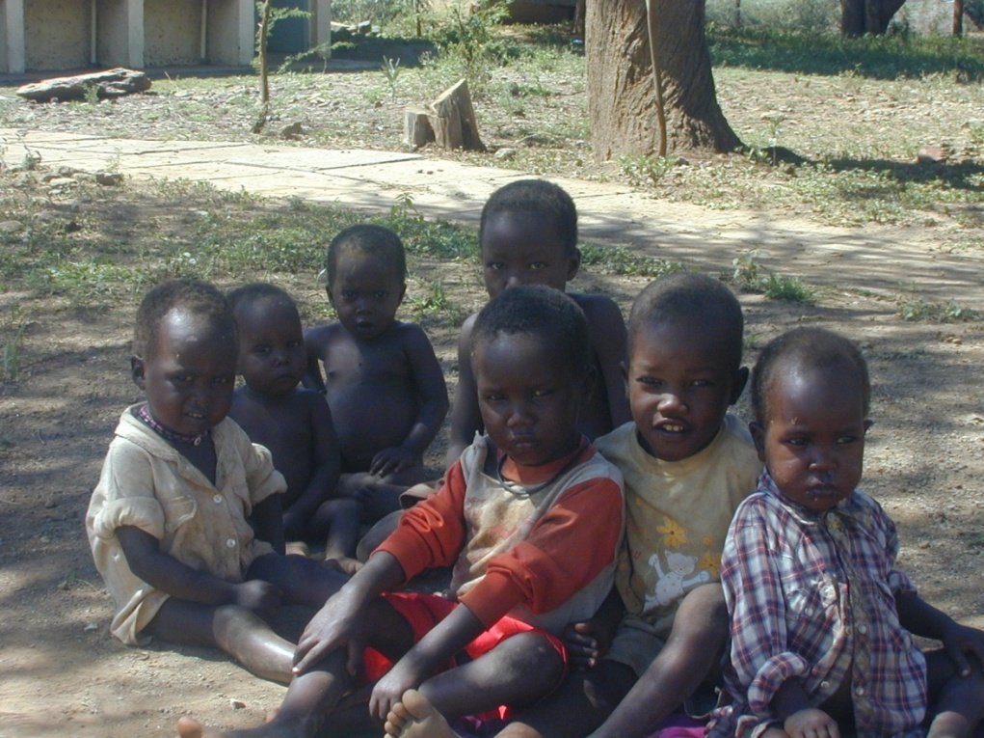
The Case for IBLI Getting Smart About Poverty Traps
Poverty traps in the southern Ethiopian rangelands
Standard humanitarian response to shocks/destitution: food aid
Pay attention to the risk and dynamics that cause destitution … else beware an aid trap!
Notes:
3

Slide 4
The Case for IBLI Insurance and Development
Economic costs of uninsured risk, esp. w/poverty traps
Sustainable insurance can:
  Prevent downward slide of vulnerable populations
  Stabilize expectations & crowd-in investment and accumulation by poor populations
  Induce financial deepening by crowding-in credit supply and demand
  Reinforce extant social insurance mechanisms
But can insurance be sustainably offered in rangelands?
Conventional (individual) insurance unlikely to work, especially among pastoralists:
  Transactions costs
  Moral hazard/adverse selection

Slide 5
The Case for IBLI Index Insurance: Advantages
Index insurance avoids problems that make individual insurance unprofitable for small, remote clients:
  No transactions costs of measuring individual losses
  Preserves effort incentives (no moral hazard) as no single individual can influence index.
  Adverse selection does not matter as payouts do not depend on the riskiness of those who buy the insurance
  Available on near real-time basis: faster response than conventional humanitarian relief
Index insurance can, in principle, be used to create an effective safety net to alter poverty dynamics and help address broad-scale shocks

Slide 6
The Case for IBLI Index Insurance: Challenges
‘Big 5’ Challenges of Sustainable Index Insurance:
  High quality data (reliable, timely, non-manipulable, long-term) to calculate premium and to determine payouts
  Minimize uncovered basis risk through product design
  Innovation incentives for insurance companies to design and market a new product
  Establish informed effective demand, especially among a clientele with little experience with any insurance, much less a complex index insurance product
  Low cost delivery mechanism for making insurance available for numerous small and medium scale producers

Slide 7
The Case for IBLI Solutions to Challenges
Solutions to the ‘Big 5’ Challenges:
  High quality data:
    Satellite data (remotely sensed vegetation index: NDVI)
  Minimize uncovered basis risk:
    Analysis of household data on herd loss
  Innovation incentives for insurers:
    Researchers do product design work, develop awareness materials and assist with capacity building
  Establish informed effective demand:
    Simulation games with real information & incentives
  Low cost mechanism:
    Delivery through partners

Slide 8
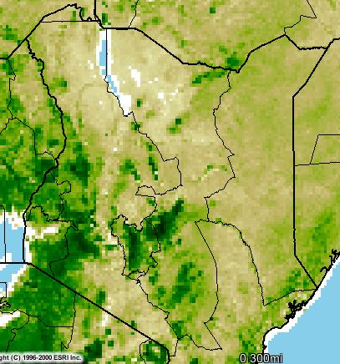
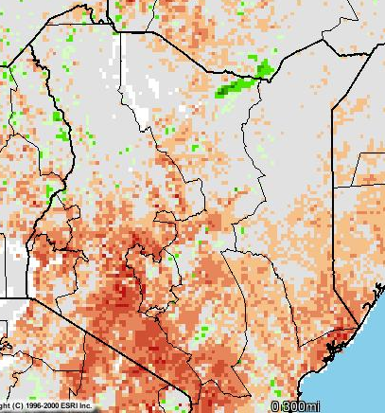
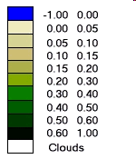
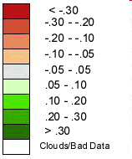
The Case for IBLI High Quality Data
NDVI (Feb 2009, Dekad 3)
ZNDVI: Deviation of NDVI from long-term average
NDVI
Laisamis Cluster, zndvi (1982-2008)
Historical droughts
NASA NDVI Image Produced By: USGS-EROS Data Center. Source: Famine Early Warning System Network (FEWS-NET)
Notes:
8

Slide 9
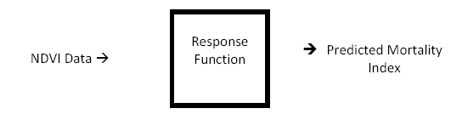

The Case for IBLI Livestock Mortality Index
NDVI-based Livestock Mortality Index
IBLI contract is based on area average livestock mortality predicted by remotely-sensed (satellite) information on vegetative cover (NDVI):
Notes:
9

Slide 10
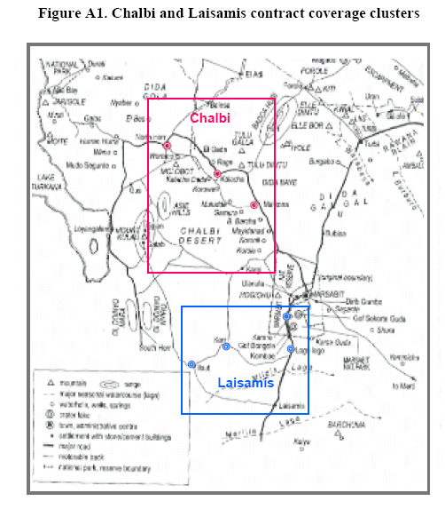
The Case for IBLI Livestock Mortality Index
Geographical Clusters:
Estimate 2 separate livestock mortality-NDVI response functions for distinct clusters in Marsabit District:
-- Chalbi (Upper Marsabit)
(arid, camel-smallstock based)
-- Laisamis (Lower Marsabit)
(semi-arid, cattle-smallstock based
Notes:
10

Slide 11
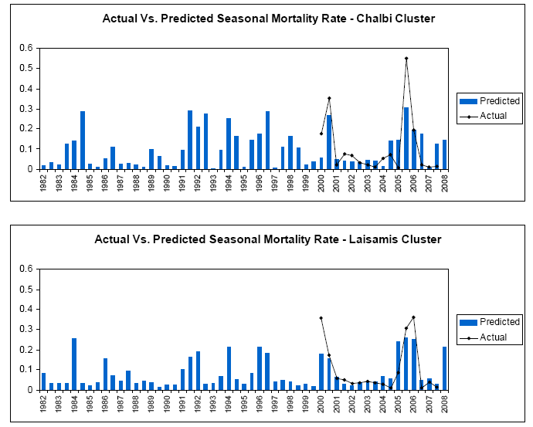
The Case for IBLI Livestock Mortality Index
Index
Performance
Notes:
11

Slide 12
The Case for IBLI Livestock Mortality Index
Index Performance
Index predicts large-scale losses very well
Notes:
12

Slide 13
The Case for IBLI Individual Basis Risk
Estimating household-level basis risk using different, household panel data (PARIMA 2000-2002; 5 locations, 30 hhs/location)
For catastrophic risk layer (>15% mortality), most losses are covariate
Used estimated household-level basis risk to simulate ex-ante performance evaluation of IBLI: basis risk modest enough not to be a key factor in product performance for households

Slide 14
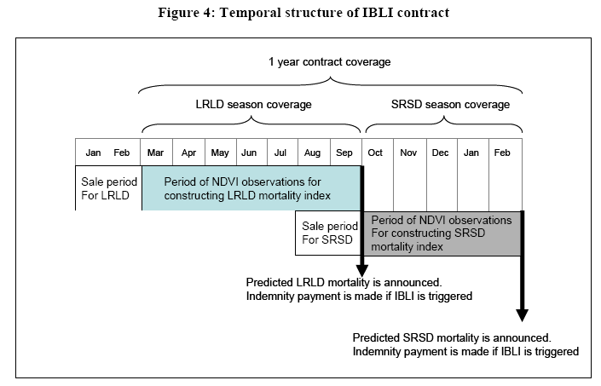
The Case for IBLI Product Design
Temporal structure of 1-year contract (2 seasonal coverage):
Seasonal insurance payment based on mortality index:
Notes:
14

Slide 15
The Case for IBLI Established Research Agenda
Experimental insurance game for generating informed demand
  Educational tool for individual clients and local leaders
  Learning local population’s response to the new product
Integrated long-term survey design for impact evaluation to inform program and policy formation
  HH survey in pilot and control locations
  Comparative assessment with unconditional cash transfer program (the Hunger Safety Nets Program: HSNP)
  Discount coupons randomly allocated to eligible subpopulations
Notes:
15

Slide 16
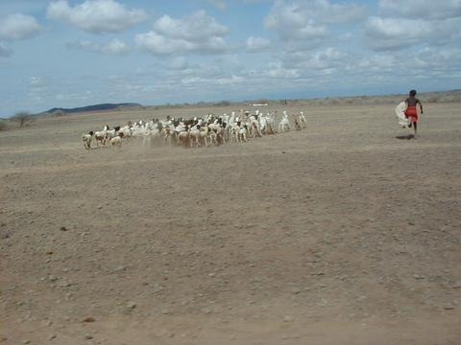
The Case for IBLI Thank you!
IBLI is a promising option for putting risk-based poverty traps behind us
Thank you for your time, interest and comments!
Notes:
16

Slide 17
The Case for IBLI For more information
Reminder, for more information:
Visit web site: http://www.ilri.org/ibli/
Barrett, C. et al. (2008). “Altering Poverty Dynamics with Index Insurance,” BASIS Brief 2008-08.
Carter, M.R., et al. (2008). “Insuring the Never-before Insured: Explaining Index Insurance through Financial Education Games,” BASIS Brief 2008-07.
Chantarat,S. et al. (2009). "The Performance of Index Based Livestock Insurance: Ex Ante Assessment in the Presence of A Poverty Trap,” Cornell/ILRI working paper.
Barrett, C.B. and M.R. Carter (2007). “Asset Thresholds and Social Protection,” IDS Bulletin 38(3):34-38.
Etc.
Notes:
17

